Slide 1
Trees

Slide 2
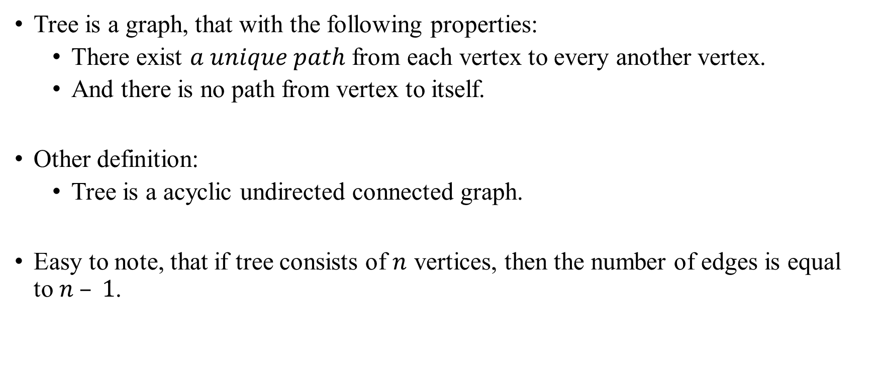
Trees
Tree is a graph, that with the following properties:
There exist $a unique path$ from each vertex to every another vertex.
And there is no path from vertex to itself.
Other definition:
Tree is a acyclic undirected connected graph.
Easy to note, that if tree consists of $n$ vertices, then the number of edges is equal to $n – 1$.

Slide 3
Trees
A node that does not have ancestors (the topmost one) is called the root node. Such tree is called rooted tree.
Level 0 is a first level, and contain only the root of tree.
Level k contains the vertices, that connected with vertices of level k – 1.
Height of tree is a largest Level of tree plus 1.
Each vertex have a parent except the root.
Leaf is a vertex that have no child.

Slide 4
Trees Example
1
2
3
4
5
6
7

Slide 5
Trees Example
root
1
Level 0
2
3
4
Level 1
leaf
Height 4
parent
5
6
Level 2
7
Level 3
child

Slide 6
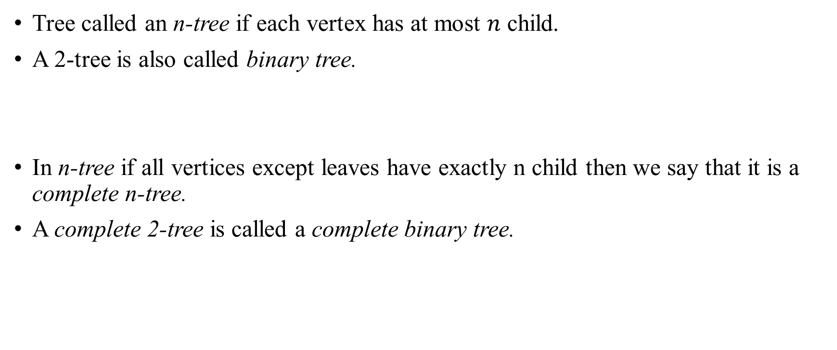
Trees
Tree called an n-tree if each vertex has at most $n$ child.
A 2-tree is also called binary tree.
In n-tree if all vertices except leaves have exactly n child then we say that it is a complete n-tree.
A complete 2-tree is called a complete binary tree.

Slide 7
Trees Subtrees
Every vertex is a root of its subtree.
For example, 3 is a root of this subtree.
0
1
2
3
4
5
6

Slide 8
Trees Traversals
Unlike linear data structures (Array, Linked List, Queues, Stacks, etc) which have only one logical way to traverse them, trees can be traversed in different ways.
Following are the generally used ways for traversing trees.

Slide 9
Trees Traversals
Depth First Traversals:
Inorder (Left, Root, Right) : 4 2 5 1 3
Preorder (Root, Left, Right) : 1 2 4 5 3
Postorder (Left, Right, Root) : 4 5 2 3 1
Breadth First: 1 2 3 4 5
1
2
3
4
5

